Slide 1

Multi-model Comparison
PLCY-798K
Integrated Human-Earth System Modeling and Policy Assessment
March 29, 2023

Slide 2
Topics for Today
Why do we do model intercomparison?
What is model intercomparison?
How has it evolved over time?
What are the main challenges in the process?

Slide 3
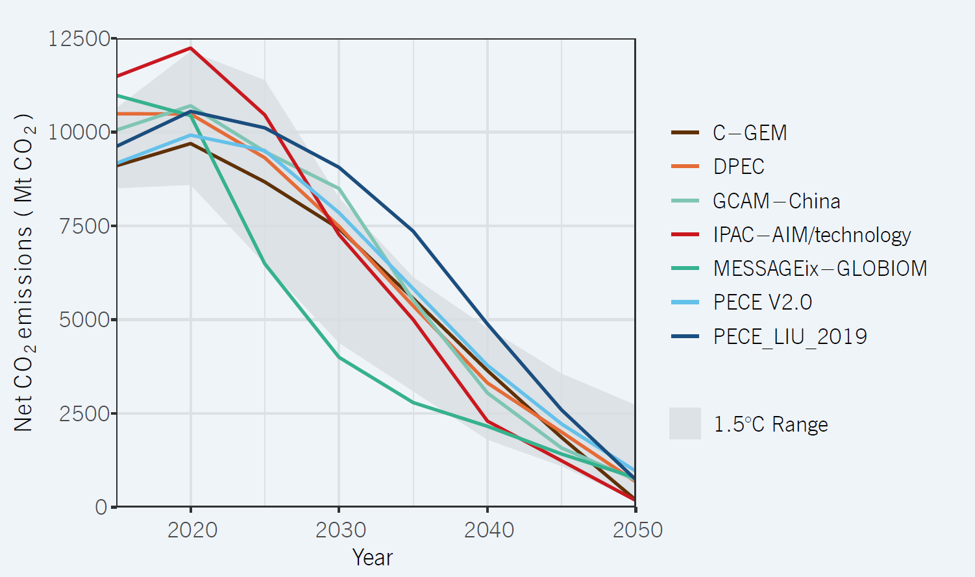
CO₂ Emissions (China)
Energy Foundation China (2020). “Synthesis Report 2020 on China’s Carbon Neutrality: China’s New Growth Pathway: from the 14th Five Year Plan to Carbon Neutrality.” Energy Foundation China, Beijing, China. Available at: https://www.efchina.org/Reports-en/report-lceg-20201210-en.
Notes:
This report synthesizes a number of quantitative scenarios from energy models, integrated assessment models, and agricultural models. It includes a set of scenarios, primarily from the CD-LINKS project, used in this report primarily to understand the nature of China’s carbon neutrality goal in a global context. This includes scenarios produced using GCAM-China, IMAGE 3.0.1, MESSAGEix-GLOBIOM 1.0, POLES CDLINKS, REMIND MAgPIE 1.7-3.0, and WITCH-GLOBIOM 4.4. This report also relies on a broader set of scenarios from multiple models to explore the details of China’s economy-wide and sectoral transitions. This includes scenarios from economy-wide models that are used to explore both sectoral and cross-sectoral strategies – C-GEM, DPEC, ERI-LEAP, GCAM-China, IPAC-AIM/technology, MESSAGEix-GLOBIOM, PECE V2.0, PECE_LIU_2019, and POLES-JRC 2019 version. It also includes several sectoral models – AGHG-INV (agriculture and land use), CBEM (buildings), ERI-Industry (industry), ICCSD-LoMLoG (electric power), and Transportation-CATS (transportation) – that are used to provide details on specific sectoral transitions. Some of these scenarios can be found in the published literature, while others were constructed specifically for this report. The scenarios are used selectively throughout the report to support conclusions and to illustrate key elements of future pathways. As the first report in this series, scenarios are largely reported here in their “native” states – that is, only minimal efforts have been made to harmonize baselines, sectoral accounting approaches, or other methodological concerns that can influence comparability across models. Greater harmonization will be undertaken in future reports.

Slide 4
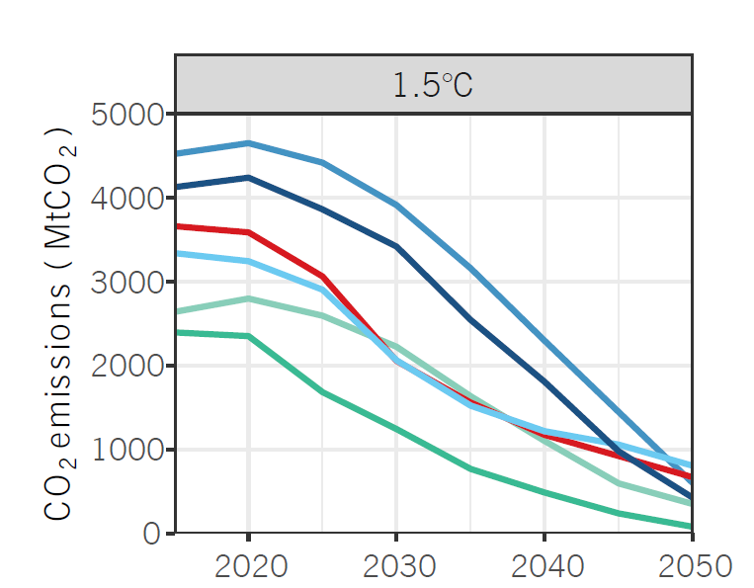
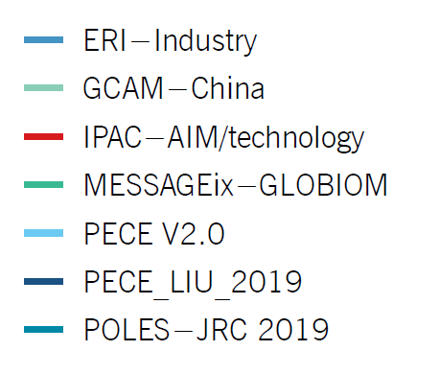
Industrial CO₂ Emissions across Models (China)
Energy Foundation China (2020). “Synthesis Report 2020 on China’s Carbon Neutrality: China’s New Growth Pathway: from the 14th Five Year Plan to Carbon Neutrality.” Energy Foundation China, Beijing, China. Available at: https://www.efchina.org/Reports-en/report-lceg-20201210-en.

Slide 5
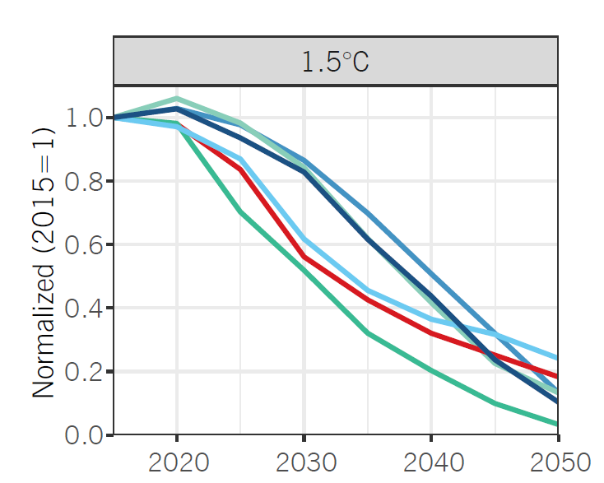
Industrial CO₂ Emissions across Models (China)
Energy Foundation China (2020). “Synthesis Report 2020 on China’s Carbon Neutrality: China’s New Growth Pathway: from the 14th Five Year Plan to Carbon Neutrality.” Energy Foundation China, Beijing, China. Available at: https://www.efchina.org/Reports-en/report-lceg-20201210-en.

Slide 6
Why Model Intercomparison?
Improve models
Develop robust insights for policy makers
“All models are wrong, but some are useful.”
Also provide guidance on how to interpret model results
Produce a sensitivity range
Identify key drivers and strategies
Identify areas of uncertainty

Slide 7
Improve Models
Spot the outliers
Most of the time, it is not a real insight but something to improve
Some are easy to fix, others are inherent with model structure
Calibration data
Key input assumptions
…
Missing important sectors/technologies
…
Inter temporal optimization vs. recursive dynamic
GE vs. PE

Slide 8
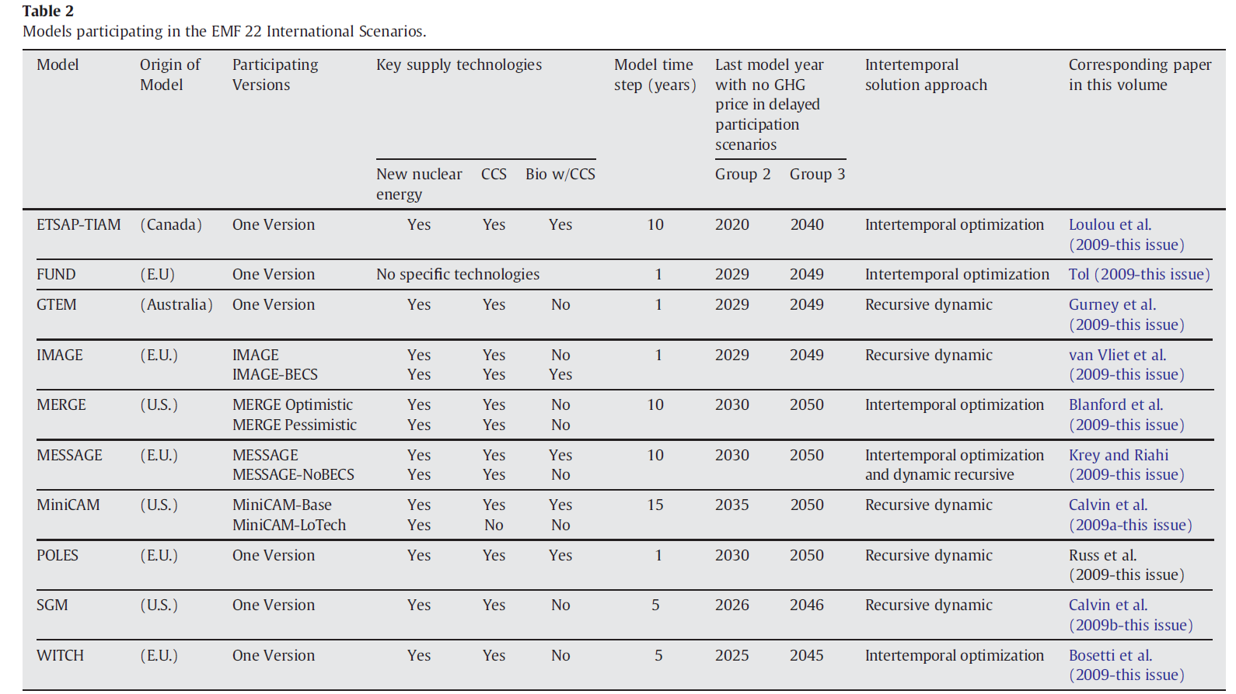
What is Model Intercomparison? -- Models
Clarke, L., Edmonds, J., Krey, V., Richels, R., Rose, S., & Tavoni, M. 2009. “International climate policy architectures: Overview of the EMF 22 International Scenarios.” Energy Economics 31(S2):S64–S81.

Slide 9
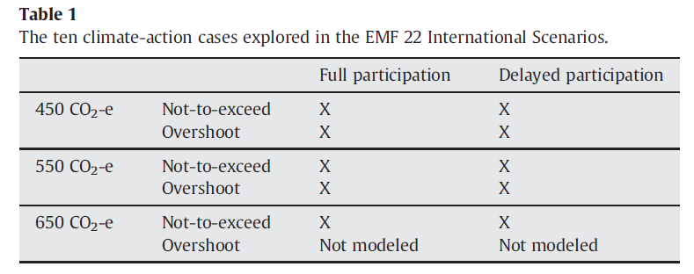
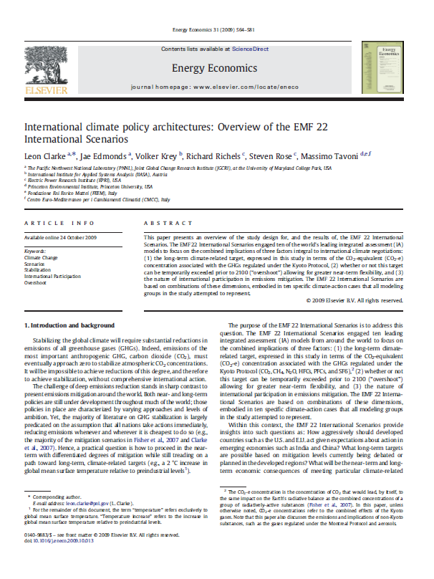
What is Model Intercomparison: A scenario protocol
Clarke, L., Edmonds, J., Krey, V., Richels, R., Rose, S., & Tavoni, M. 2009. “International climate policy architectures: Overview of the EMF 22 International Scenarios.” Energy Economics 31(S2):S64–S81.

Slide 10
What is Model Intercomparison
A question
Models
Scenario design
Funders
Steering committee
A schedule
A facility to collect data
A process for producing comparison charts to compare models
Meetings for discussion of results
Time to allow teams to make improvements and adjust
A process for getting the results published

Slide 11
History and Types of IAM Modeling Intercomparison
Energy Modeling Forum https://emf.stanford.edu/
EMF 37: Deep Decarbonization & High Electrification Scenarios for North America
EMF 36: Carbon Pricing After Paris (CarPri)
EMF 35: Japan model intercomparison project (JMIP) on long-term climate policy
EMF 34: North American Energy Trade and Integration
EMF 33: Bio-Energy and Land Use
EMF 32: US GHG and Revenue Recycling Scenarios
EMF 31: North American Natural Gas Markets in Transition
EMF 30: Short Lived Climate Forcers / Air Quality
EMF 29: The Role of Border Carbon Adjustment in Unilateral Climate Policy
EMF 27: Global Model Comparison Exercise
EMF 24: U.S. Technology and Climate Policy Strategies
EMF 22: Climate Change Control Scenarios
EMF 21: Multi-Gas Mitigation and Climate Change
EMF 19: Climate Change: Technology Strategies and International Trade
EMF 16: The Costs of the Kyoto Protocol
EMF 1: Energy and the Economy (1977)
European Studies
AMPERE
COMMIT
ENGAGE
CD-LINKS
NDC-ASPECTS
ADVANCE
ELEVATE…
Targeted Studies
Latin American Modeling Project
Climate Change Science Program Scenarios
Asian Modeling Exercise….
Multi-Model Papers and Reports
IPCC Assessment and Special Reports

Slide 12
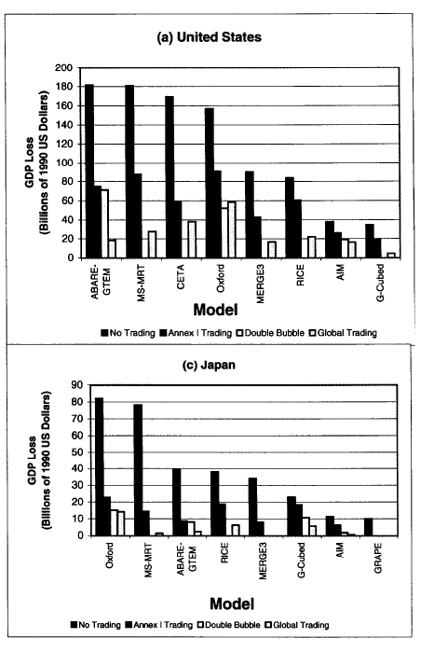
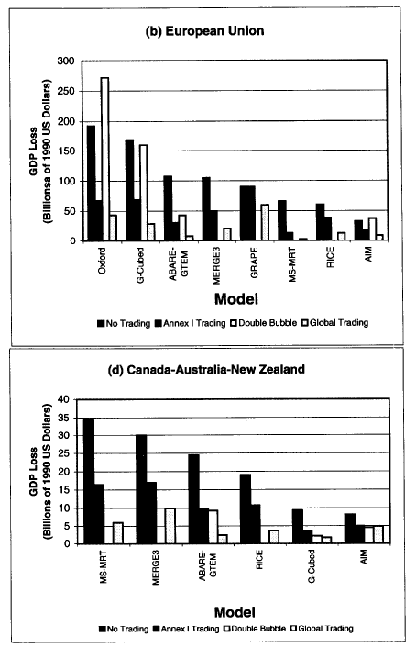
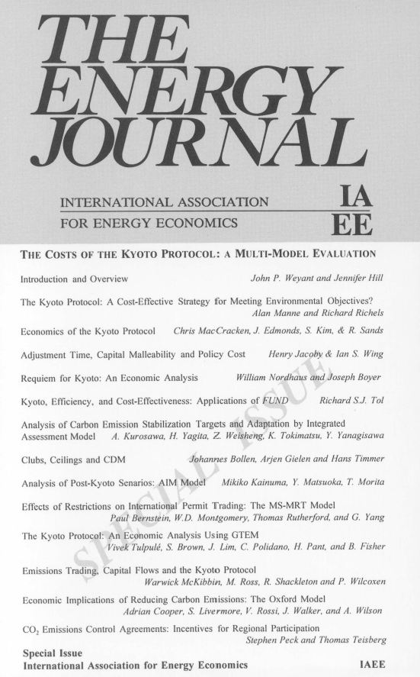
EMF 16 on the Costs of the Kyoto Protocol (1999)
Emissions Trading
Economic Efficiency
Emissions Trading
Hot Air
Weyant, John P., and Jennifer N. Hill. "INTRODUCTION AND OVERVIEW." The Energy Journal Vol. 20, Special Issue: The Costs of the Kyoto Protocol: A Multi-Model Evaluation (1999), pp. vii-xliv (38 pages). http://www.jstor.org/stable/23296903

Slide 13

2009: The Copenhagen Climate Conference

Slide 14
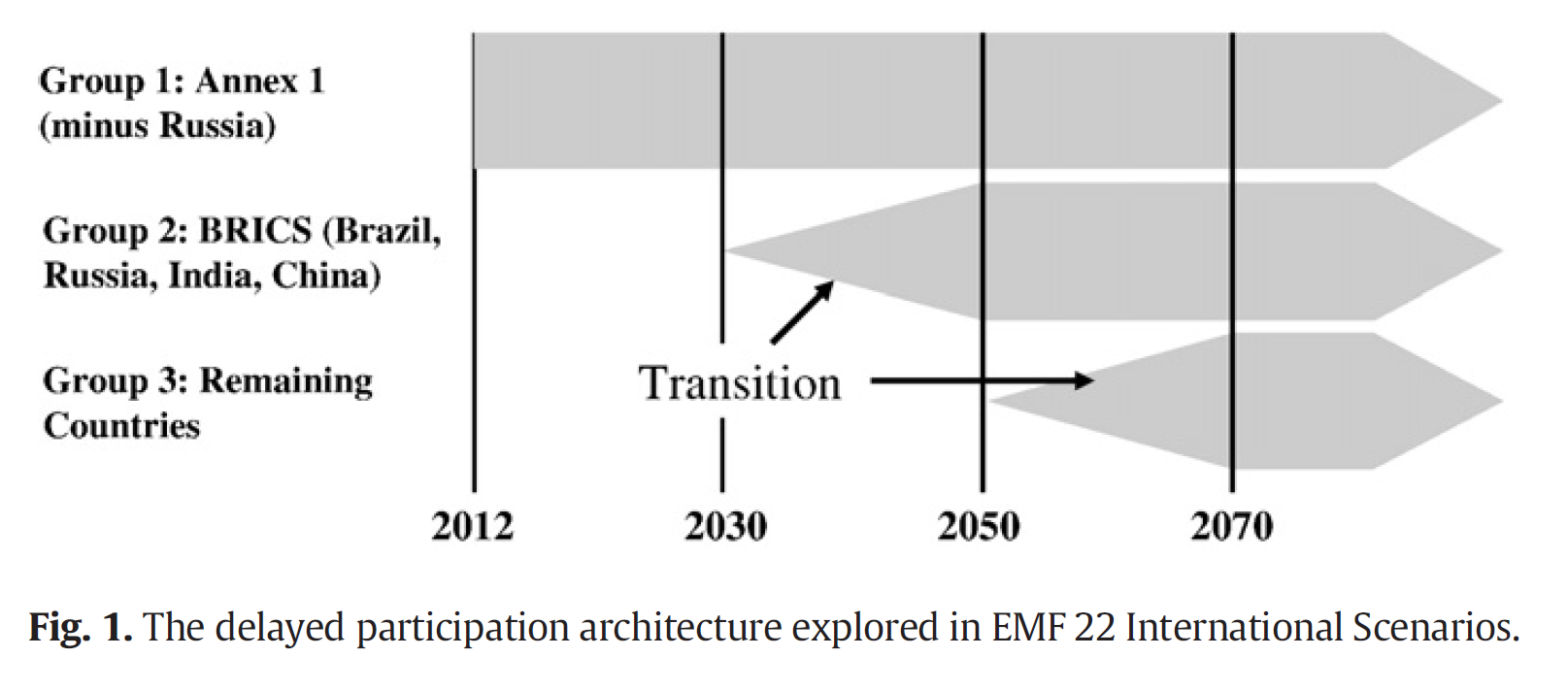
EMF 22: Second-Best International Policy Structures (2009)
How do we achieve long-term climate goals if countries do not all act at once? How does overshoot influence these dynamics?
Clarke, L., Edmonds, J., Krey, V., Richels, R., Rose, S., & Tavoni, M. 2009. “International climate policy architectures: Overview of the EMF 22 International Scenarios.” Energy Economics 31(S2):S64–S81.

Slide 15
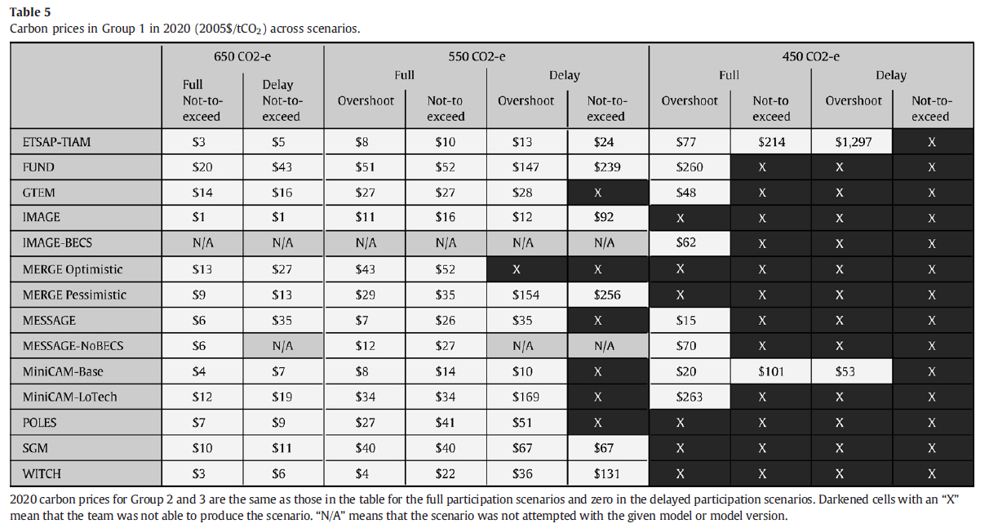
EMF 22: Second-Best International Policy Structures (2009)

Slide 16
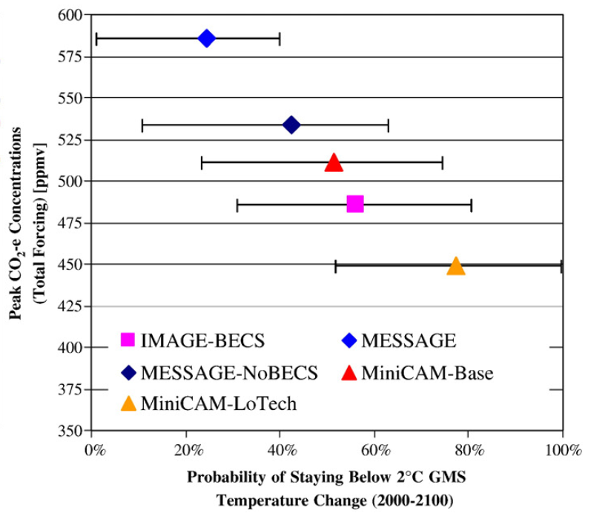
EMF 22: Second-Best International Policy Structures (2009)
“Second Best” Mitigation
Delayed Accession
Probabilistic Temperature
Annex 1 Mitigation
BECCS
450 ppmv CO2e
“Feasibility”
Overshoot

Slide 17
EMF 22: Second-Best International Policy Structures (2009): U.S. Emissions
Clarke, L., Edmonds, J., Krey, V., Richels, R., Rose, S., & Tavoni, M. 2009. “International climate policy architectures: Overview of the EMF 22 International Scenarios.” Energy Economics 31(S2):S64–S81.
587 CO₂-e peak
502 CO₂-e peak
530 CO₂-e peak
523 CO₂-e peak
Scenarios that could not be modeled under criteria of study.

Slide 18
EMF 22: Second-Best International Policy Structures (2009): U.S. Emissions
Clarke, L., Edmonds, J., Krey, V., Richels, R., Rose, S., & Tavoni, M. 2009. “International climate policy architectures: Overview of the EMF 22 International Scenarios.” Energy Economics 31(S2):S64–S81.
50 Percent Reduction Below 2000
80 Percent Reduction Below to 2000
Scenarios that could not be modeled under criteria of study.

Slide 19
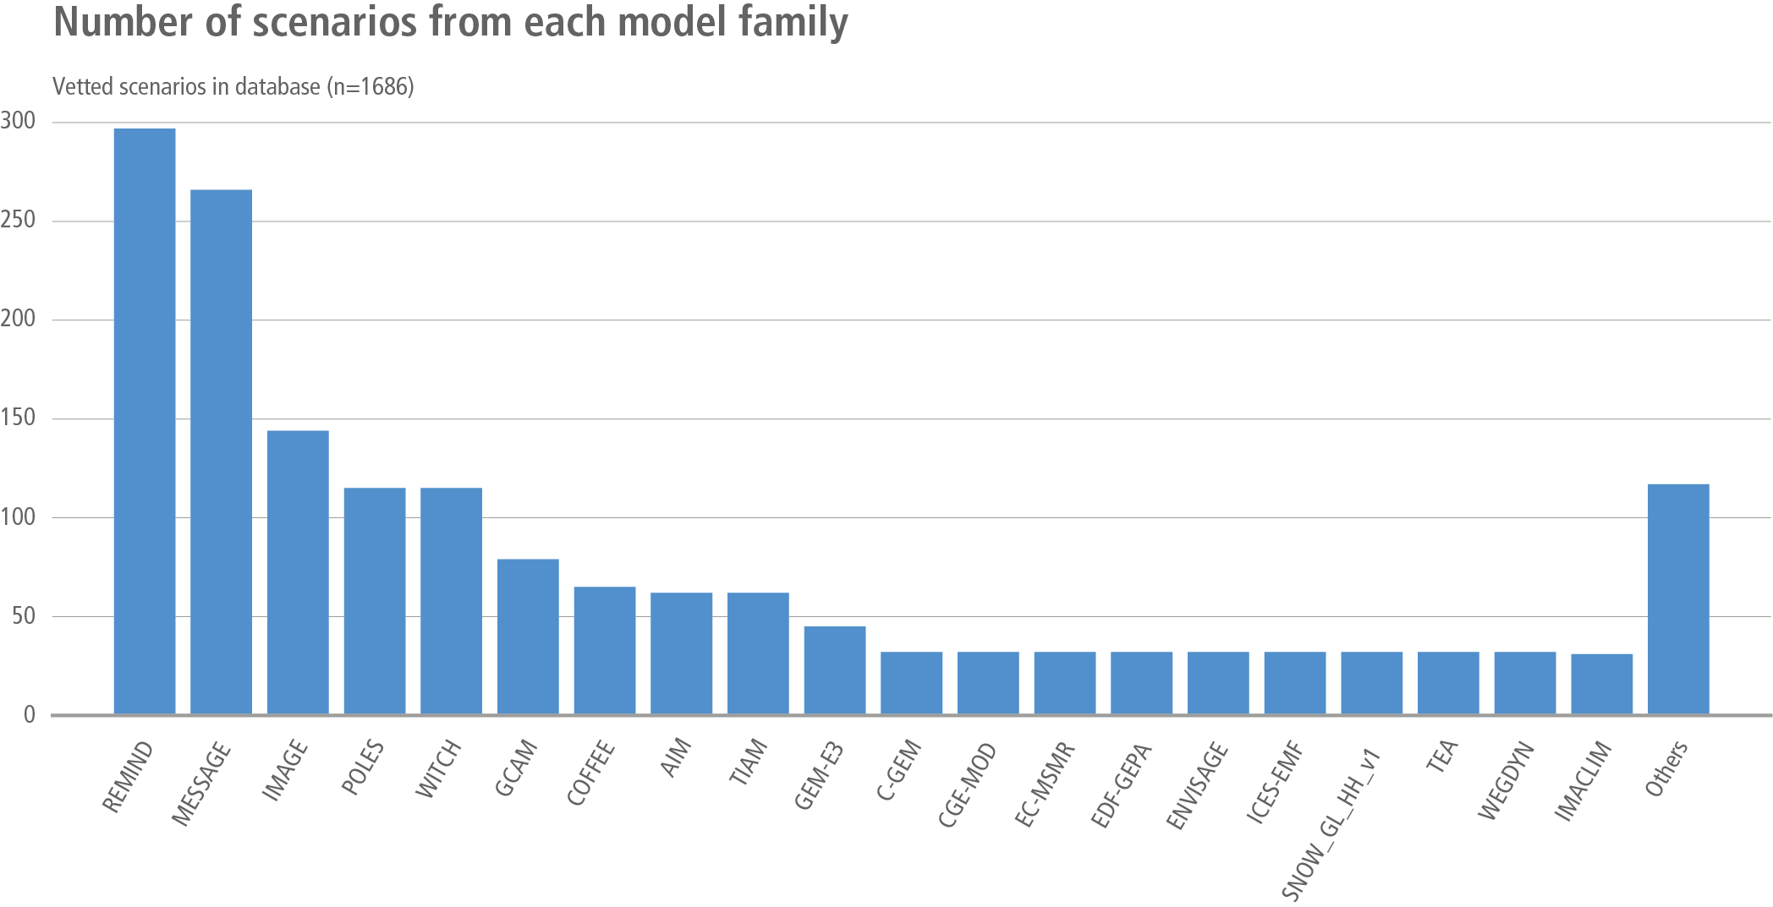
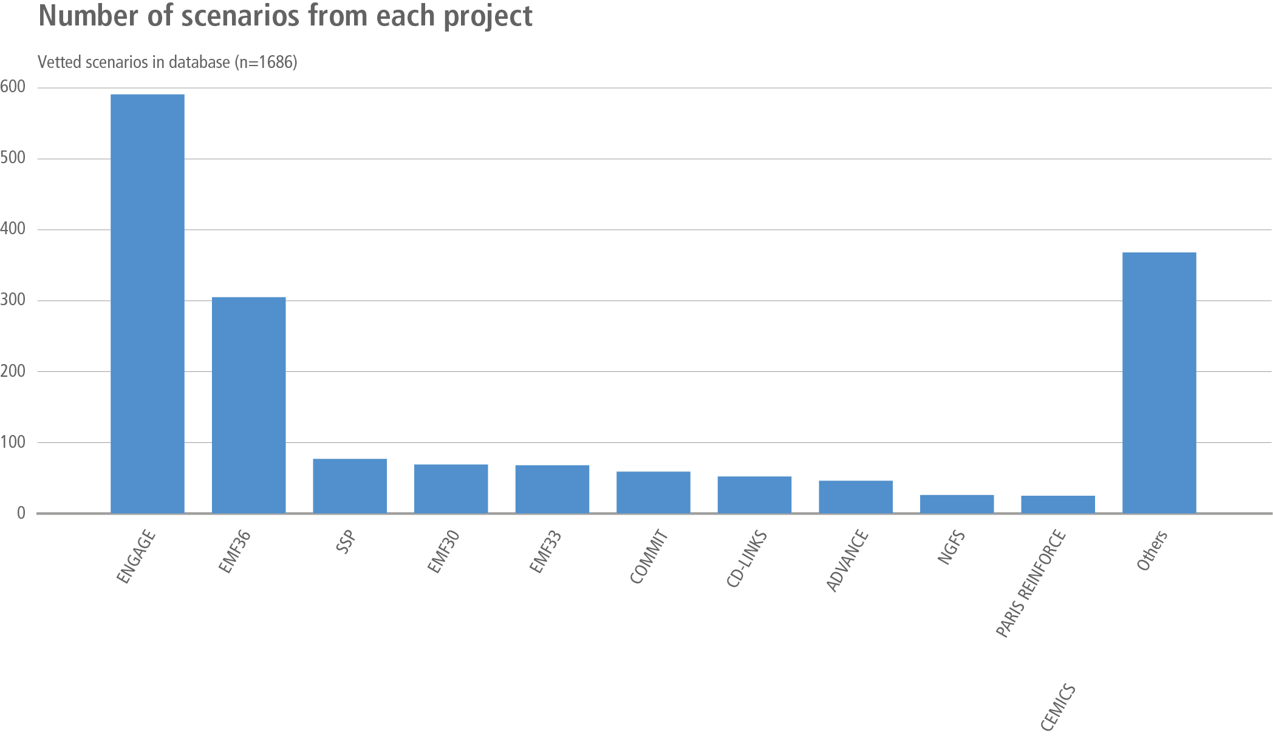
Multi-model studies contribute to a large portion of IPCC scenarios
AR6 Scenario Explorer and Database hosted by IIASA
Riahi, K., R. Schaeffer, J. Arango, K. Calvin, C. Guivarch, T. Hasegawa, K. Jiang, E. Kriegler, R. Matthews, G.P. Peters, A. Rao, S. Robertson, A.M. Sebbit, J. Steinberger, M. Tavoni, D.P. van Vuuren, 2022: Mitigation pathways compatible with long-term goals. In IPCC, 2022: Climate Change 2022: Mitigation of Climate Change. Contribution of Working Group III to the Sixth Assessment Report of the Intergovernmental Panel on Climate Change [P.R. Shukla, J. Skea, R. Slade, A. Al Khourdajie, R. van Diemen, D. McCollum, M. Pathak, S. Some, P. Vyas, R. Fradera, M. Belkacemi, A. Hasija, G. Lisboa, S. Luz, J. Malley, (eds.)]. Cambridge University Press, Cambridge, UK and New York, NY, USA. doi: 10.1017/9781009157926.005

Slide 20
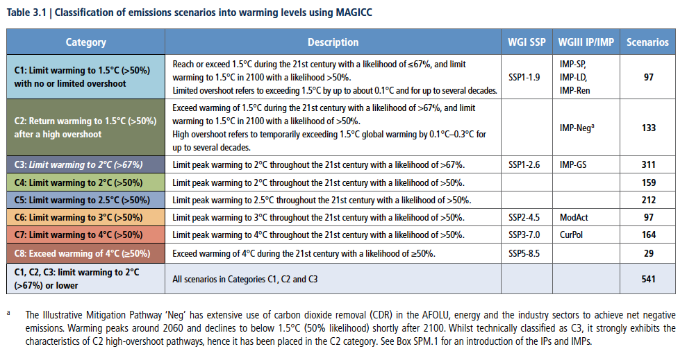
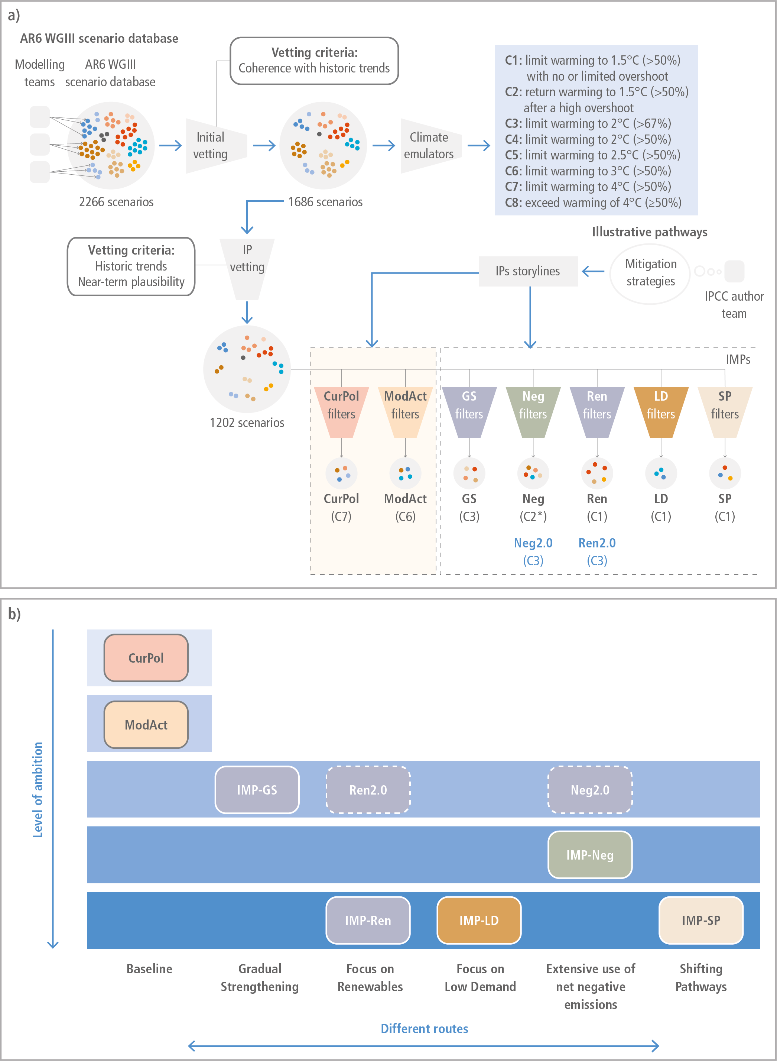
Multi-model studies contribute to a large portion of IPCC scenarios
AR6 Scenario Explorer and Database hosted by IIASA
Riahi, K., R. Schaeffer, J. Arango, K. Calvin, C. Guivarch, T. Hasegawa, K. Jiang, E. Kriegler, R. Matthews, G.P. Peters, A. Rao, S. Robertson, A.M. Sebbit, J. Steinberger, M. Tavoni, D.P. van Vuuren, 2022: Mitigation pathways compatible with long-term goals. In IPCC, 2022: Climate Change 2022: Mitigation of Climate Change. Contribution of Working Group III to the Sixth Assessment Report of the Intergovernmental Panel on Climate Change [P.R. Shukla, J. Skea, R. Slade, A. Al Khourdajie, R. van Diemen, D. McCollum, M. Pathak, S. Some, P. Vyas, R. Fradera, M. Belkacemi, A. Hasija, G. Lisboa, S. Luz, J. Malley, (eds.)]. Cambridge University Press, Cambridge, UK and New York, NY, USA. doi: 10.1017/9781009157926.005

Slide 21
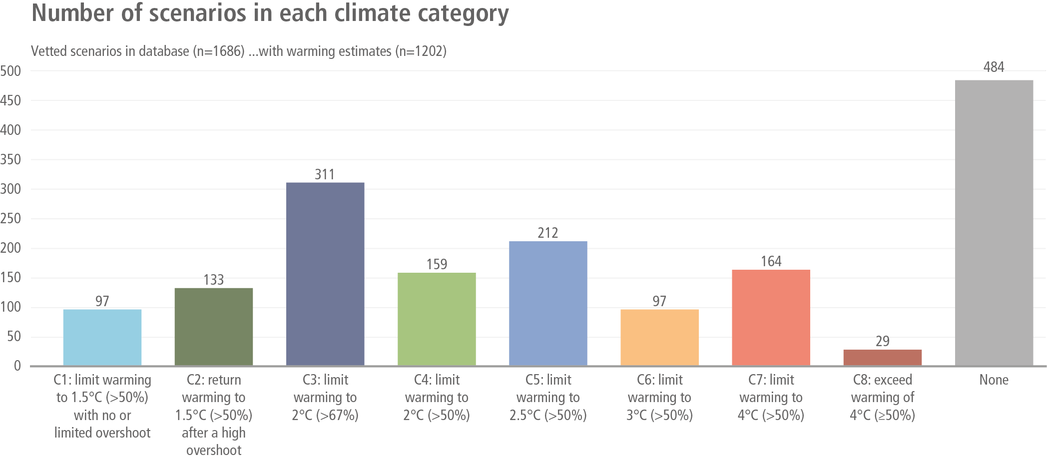
Multi-model studies contribute to a large portion of IPCC scenarios
AR6 Scenario Explorer and Database hosted by IIASA
Riahi, K., R. Schaeffer, J. Arango, K. Calvin, C. Guivarch, T. Hasegawa, K. Jiang, E. Kriegler, R. Matthews, G.P. Peters, A. Rao, S. Robertson, A.M. Sebbit, J. Steinberger, M. Tavoni, D.P. van Vuuren, 2022: Mitigation pathways compatible with long-term goals. In IPCC, 2022: Climate Change 2022: Mitigation of Climate Change. Contribution of Working Group III to the Sixth Assessment Report of the Intergovernmental Panel on Climate Change [P.R. Shukla, J. Skea, R. Slade, A. Al Khourdajie, R. van Diemen, D. McCollum, M. Pathak, S. Some, P. Vyas, R. Fradera, M. Belkacemi, A. Hasija, G. Lisboa, S. Luz, J. Malley, (eds.)]. Cambridge University Press, Cambridge, UK and New York, NY, USA. doi: 10.1017/9781009157926.005

Slide 22
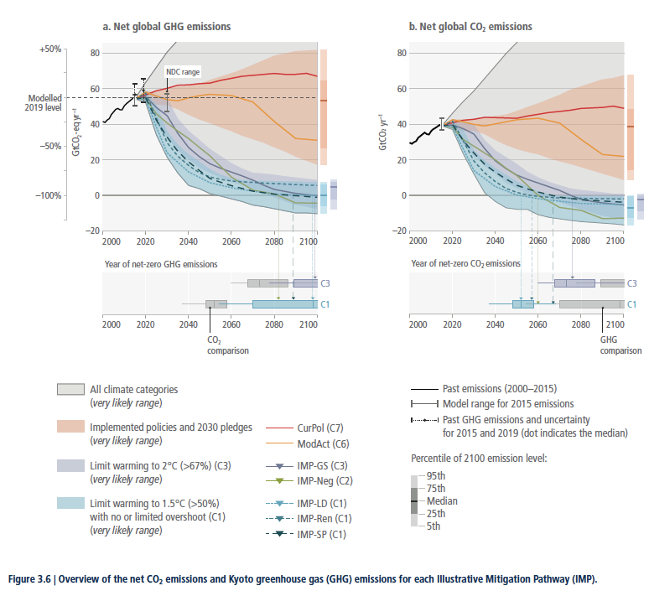
Multi-model studies contribute to a large portion of IPCC scenarios
AR6 Scenario Explorer and Database hosted by IIASA
Riahi, K., R. Schaeffer, J. Arango, K. Calvin, C. Guivarch, T. Hasegawa, K. Jiang, E. Kriegler, R. Matthews, G.P. Peters, A. Rao, S. Robertson, A.M. Sebbit, J. Steinberger, M. Tavoni, D.P. van Vuuren, 2022: Mitigation pathways compatible with long-term goals. In IPCC, 2022: Climate Change 2022: Mitigation of Climate Change. Contribution of Working Group III to the Sixth Assessment Report of the Intergovernmental Panel on Climate Change [P.R. Shukla, J. Skea, R. Slade, A. Al Khourdajie, R. van Diemen, D. McCollum, M. Pathak, S. Some, P. Vyas, R. Fradera, M. Belkacemi, A. Hasija, G. Lisboa, S. Luz, J. Malley, (eds.)]. Cambridge University Press, Cambridge, UK and New York, NY, USA. doi: 10.1017/9781009157926.005

Slide 23
The Evolution of Model Intercomparison
Grown in size and scope
An increasingly accepted part of the analysis process
Has evolved from EMF leadership to a broad set of different efforts
Has evolved from just one overview paper to multiple subgroups writing their own papers
The topics have changed

Slide 24
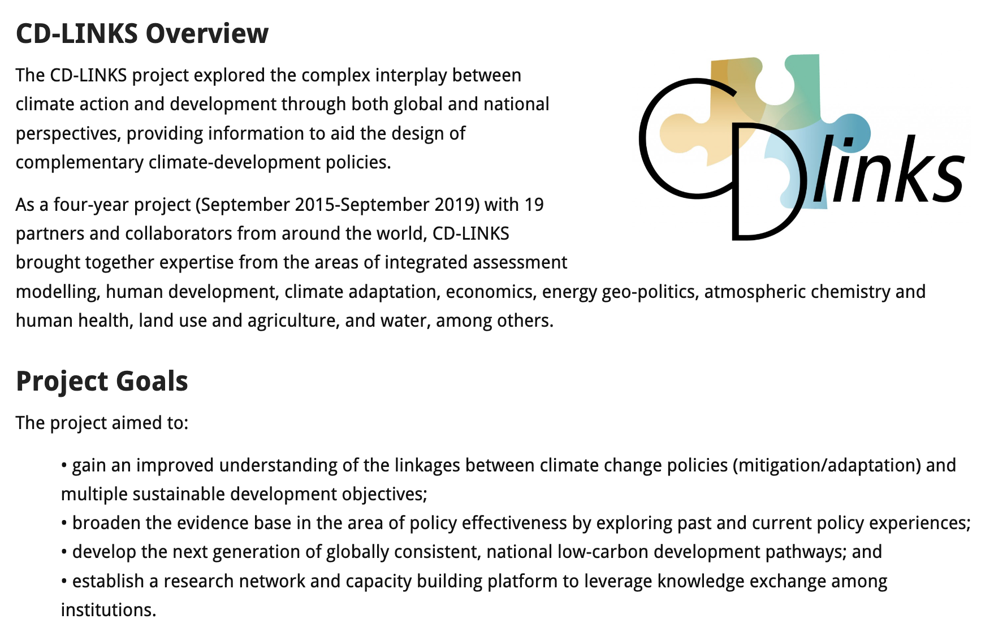

Slide 25
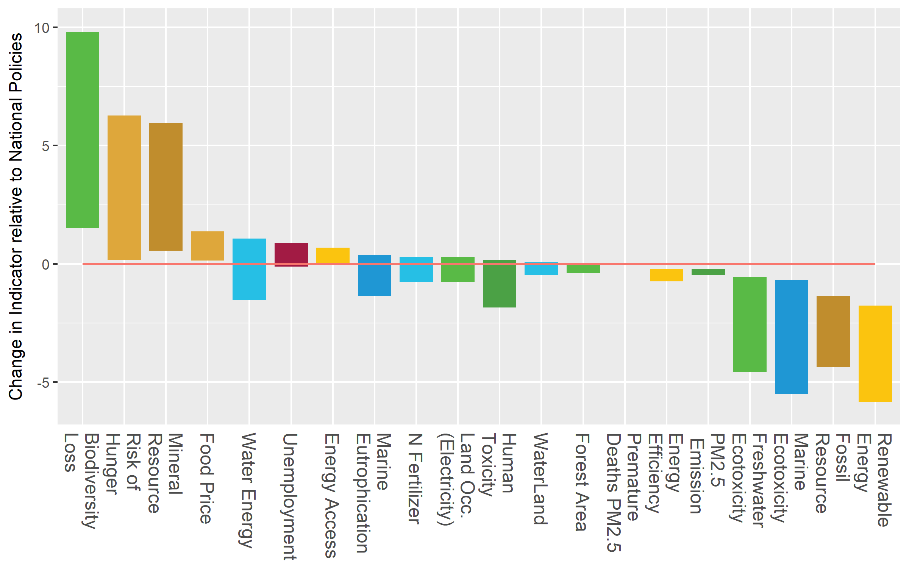
CD-Links: 1.5°C and SDGs
Robust adverse effects
Direction depends on
mitigation strategy
adverse effect
Robust co-benefits
co-benefit

Slide 26

NGFS Scenarios for Central Banks and Supervisors
The NGFS scenarios have been developed to provide a common starting point for analyzing climate risks to the economy and financial system.
These are detailed scenarios that analyze both the physical and transition risks from climate change and their economic impacts.
These have been created through a suite of models, supported by a consortium of world leading climate scientists and modeling teams.
Key users of the NGFS scenarios include a growing number of central banks, supervisors, governments, and private firms to better understand risks to financial systems, economies and their own businesses and balance sheets.

Slide 27
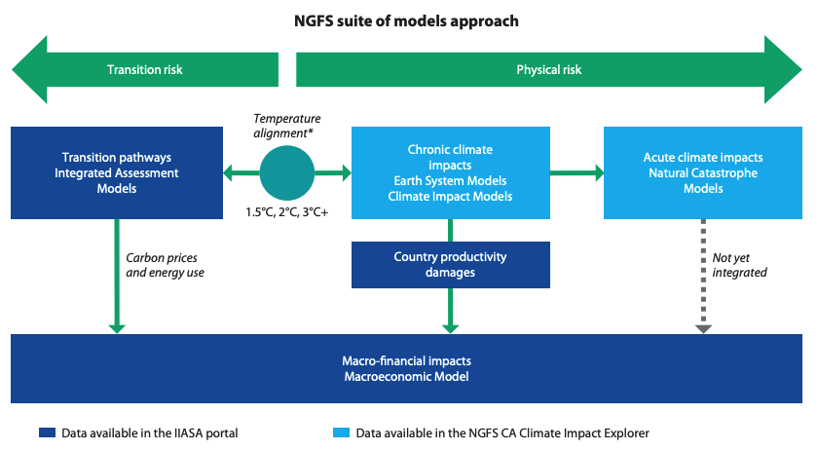
The scenarios have been created through a suite of models, aligned in a coherent way
Explored in Phase III
https://www.ngfs.net/sites/default/files/media/2021/08/27/ngfs_climate_scenarios_phase2_june2021.pdf
Notes:
Avg. temp, precipitation
Extreme events, frequency and magnitude -> input as shocks to NiGEM
Macro-finance impacts: inflation, unemployment, equity risks, exchange rate, interest rates, housing prices, trade…
Climate variables can be explored through the NGFS Climate Impact Explorer hosted by Climate Analytics. More granular data are available via the ISIMIP project. Physical risk analysis was supported by Climate Analytics, ETH Zurich and PIK.

Slide 28
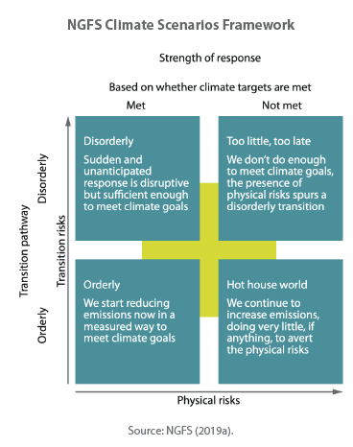
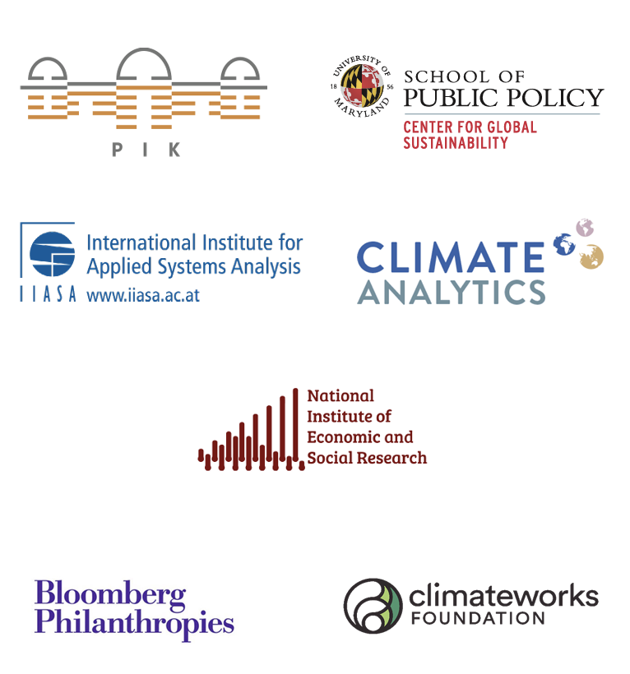
NGFS Scenarios are supported by a consortium of world leading climate scientists and modeling teams
Research Consortium
Quarterly Statistical Macroeconomic Model
Financial Support

Slide 29
Challenges
What do we make of the variation in the model results? How do we handle uncertainty?
How do we compare models with very different characteristics
Untangling why models give different results
Identifying “good” results – assessing models
Models that don’t solve.
Data collection and consistency
Funding and getting interest from the modelers
Different model capabilities (regions, sectors, etc.)

Slide 30
IIASA databases
AR6 Scenario Explorer and Database hosted by IIASA
IAMC 1.5°C Scenario Explorer hosted by IIASA

Slide 31
Questions

